Slide 2
Online group video meetings are the easiest way to grow your practice and expand your influence.
Affordable platforms and user friendly software make it easy to create engaging curriculum and course content.
You'll learn how to package handouts and worksheets as well as audio and video content to create dynamic programs that will enhance your client’s experience and boost your bottom line.
Explore effective strategies to market your courses so you can increase the profitability of your practice and attract clients from all around the world.

Slide 3
How many of you do counseling as well as coaching?
How many of you only do coaching?
What genres of coaching do you practice?
How many of you exclusively see clients in your office or home?
How many of you use a video conferencing platform to see clients?
Do any of you currently have online group classes?
How many of you have written a book?
How many of you want to write a book?

Slide 4
Creating Content

Slide 5
Let Go & Thrive is an
8-week online coaching group starts Sept 3

Slide 6
6 week online coaching group on boundaries
Starts September 3

Slide 8
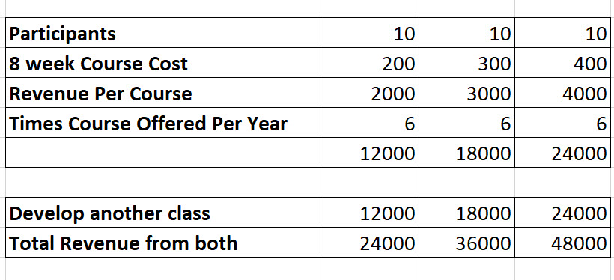

Slide 9
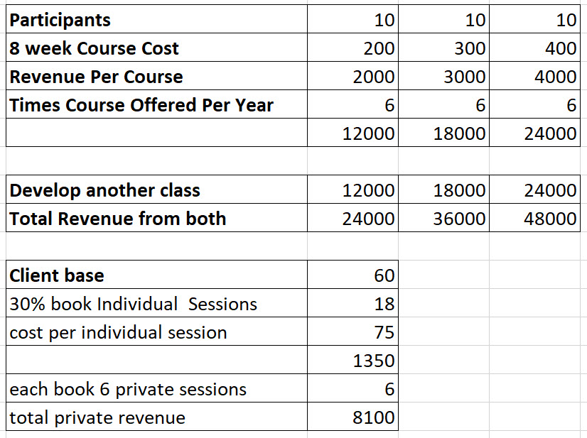

Slide 10
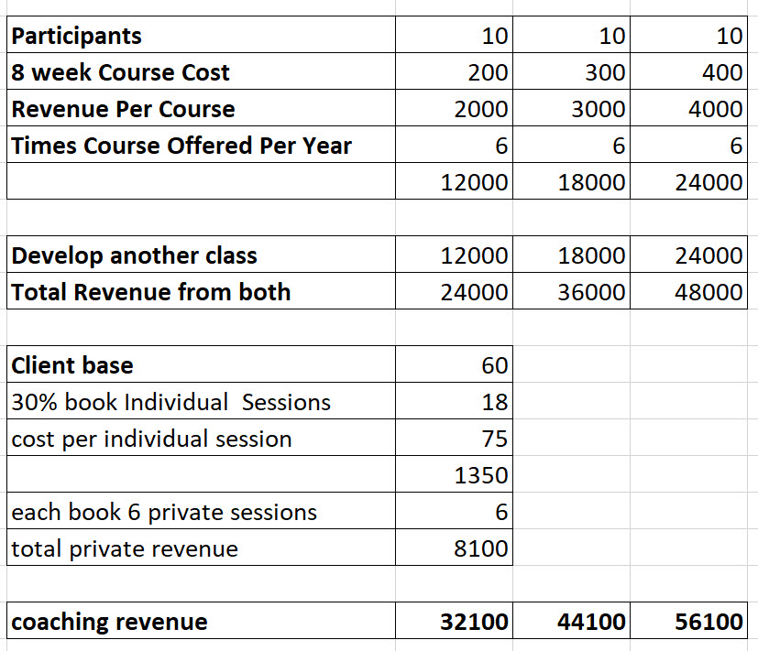

Slide 12
Decide where you will host your content
On a course creator platform
Teachable
Udemy
Zenler
Thrive Apprentice
On a private page on your website

Slide 13
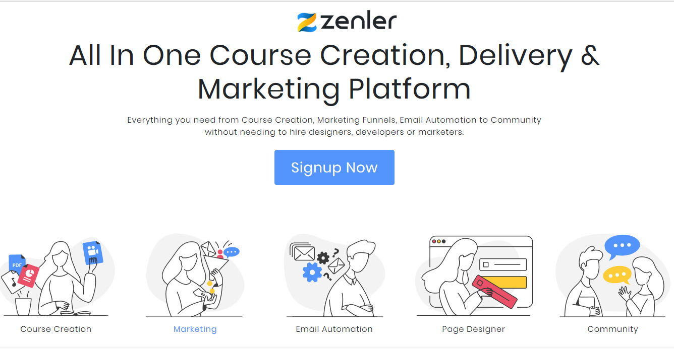

Slide 14
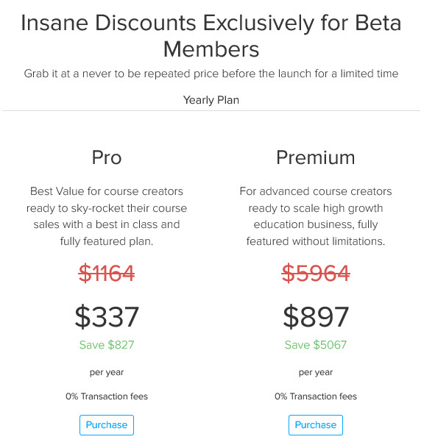
Zenler did offer a
FREE BETA version available to see if you like it.

Slide 15
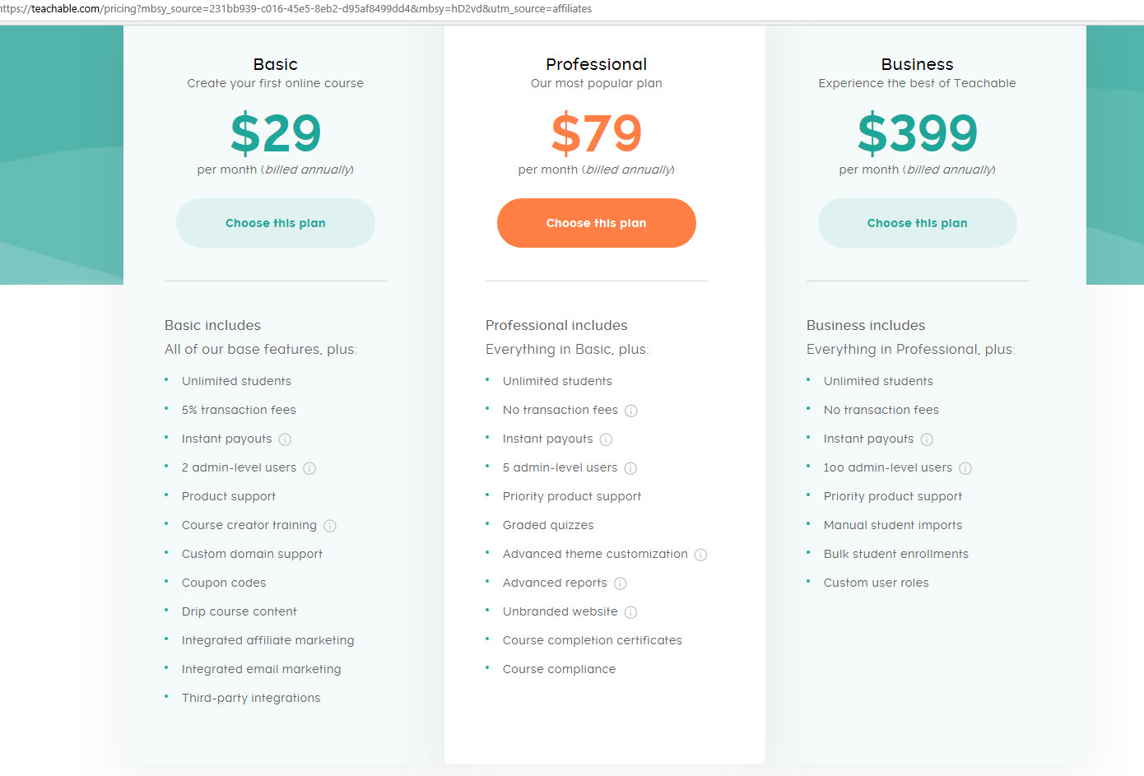
Teachable
has a free plan as well

Slide 16
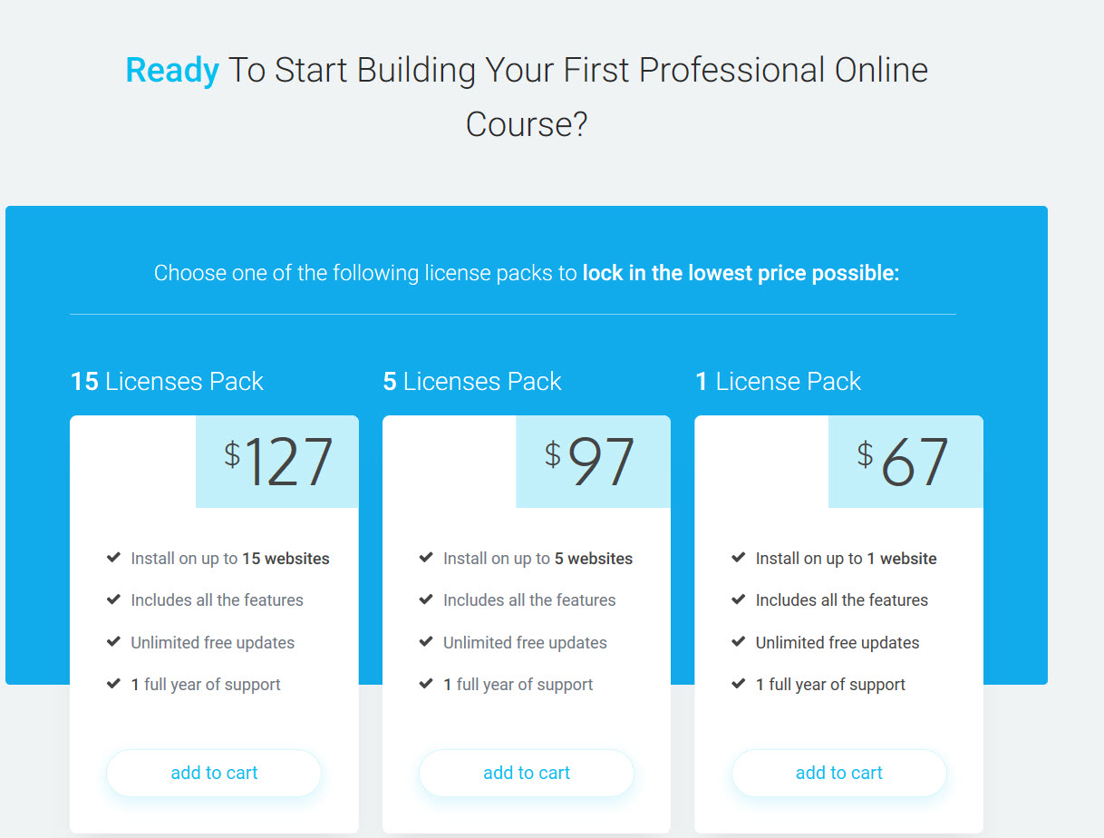
Thrive
Apprentice

Slide 17
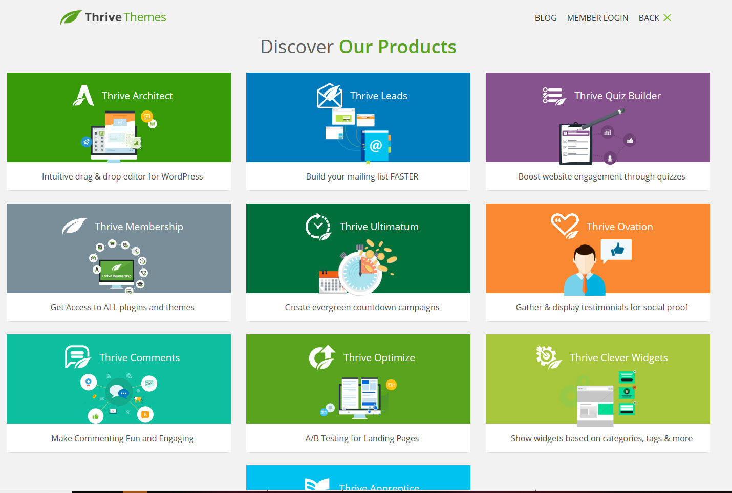
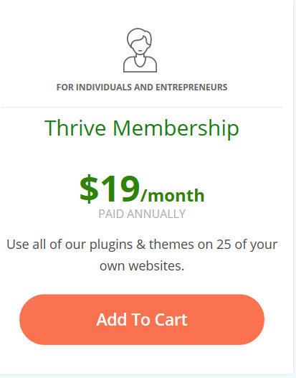
Thrive Themes
get access to all of their products for $19 month

Slide 18
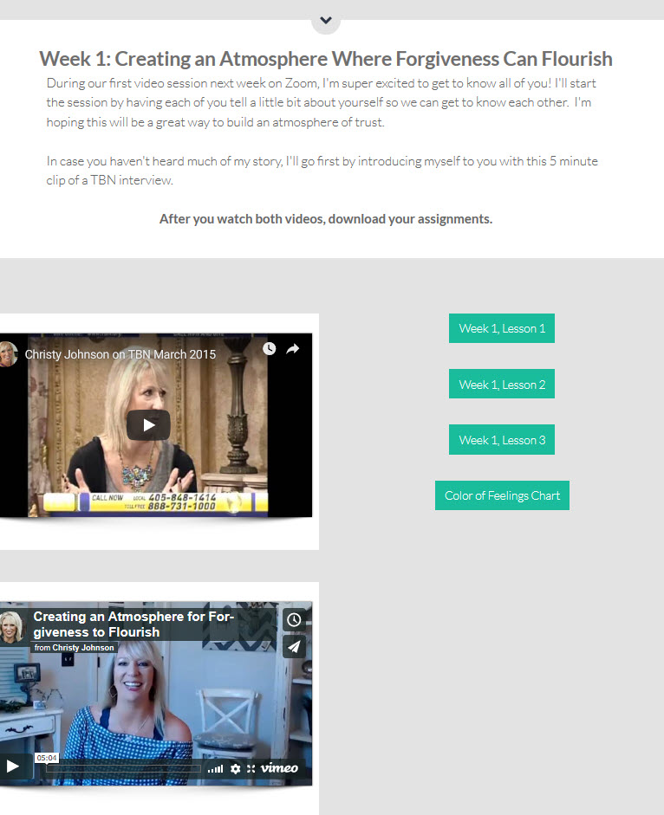

Slide 19
Tools to:
Create worksheets
Accept payment
Create audio & video

Slide 20
Creating worksheets and handouts
Word Doc versus pdf

Slide 21
Square
Credit card over the phone
Facebook
Create a Paypal button

Slide 22
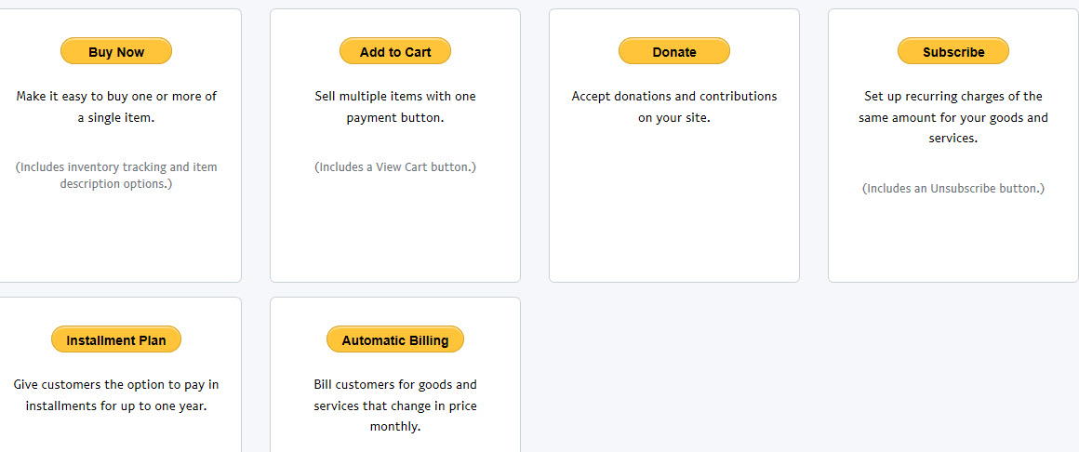
To create a Paypal button in Paypal
Go to My Paypal
Tools
All Tools
Integrate Paypal
PayPal Buttons
Choose your style
Copy and paste the code onto your website page

Slide 23
Audio & Video

Slide 24
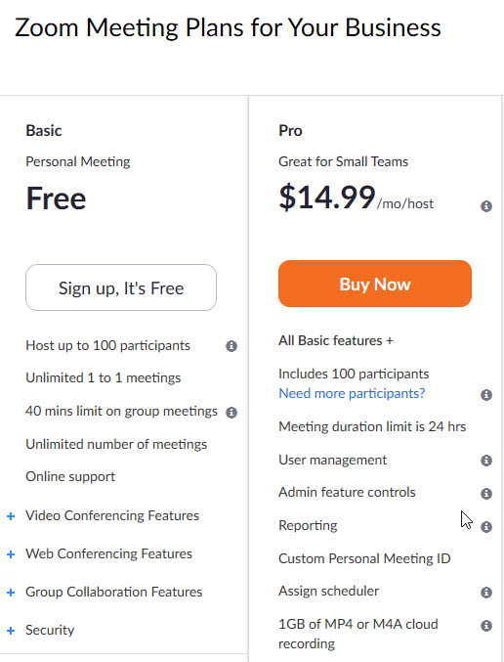
Video Communications Platform
Audio, video,
One-on-one or group
Live calls or webinars

Slide 25
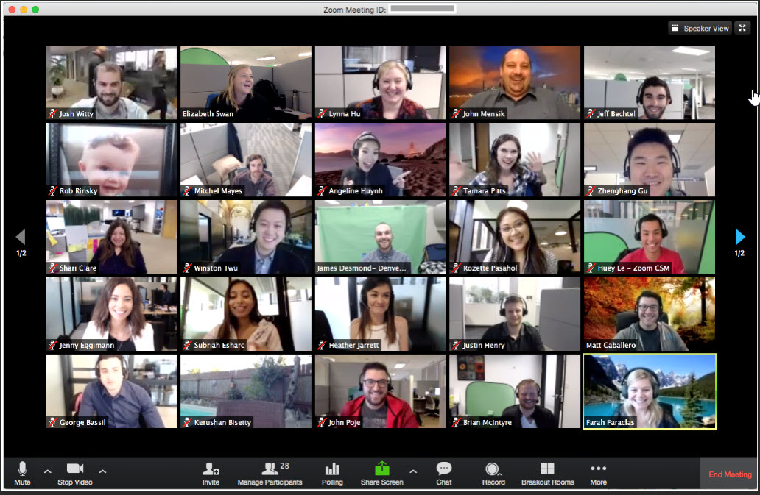

Slide 26
Marketing Essentials
Attract
Connect
Explain

Slide 27
If you build it they will come is a lie

Slide 28
If you build it they will come is a lie

Slide 29
“If you build it they will come.”

Slide 30
“If you build it they will come.”

Slide 31
Attract
Gaining Exposure for your group

Slide 32
Attracting clients outside of your zip code
Host a free webinar
Do a Facebook Live
Be a podcast Guest
Speaking Events
Create a YouVersion Bible plan

Slide 33
Lead Magnet

Slide 35
www.adazing.com
Enter your cover for free mock ups

Slide 36
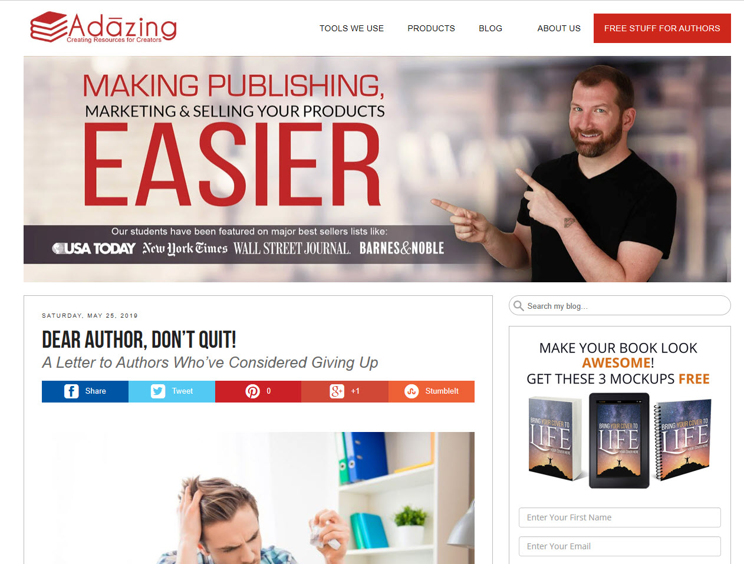

Slide 40
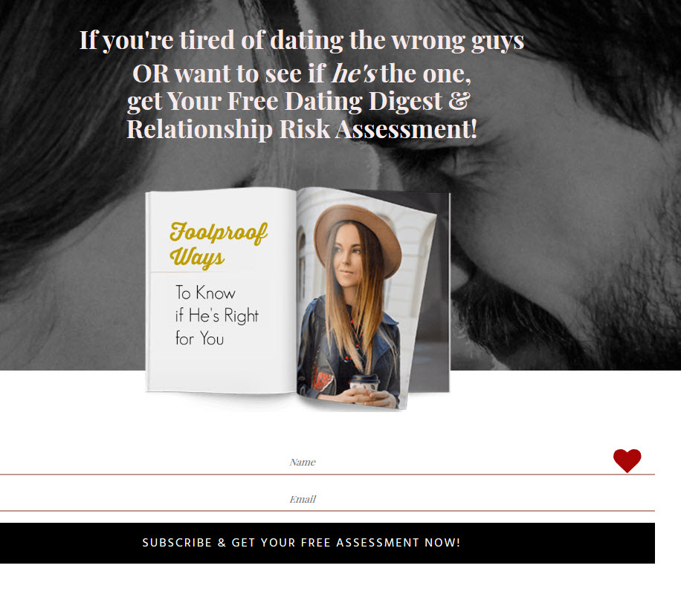

Slide 41
Website Lead Magnet Ideas
Quizzes
A free ebook
Report
Private blog post with relevant information
Video
Audio recording
Other (how to articles, first chapter of your book)

Slide 42
Book Lead Magnet Ideas
Back Matter Links
Create back matter directing them to something free
Create a link to a landing page where they have to enter their email address to get it
Once subscribed, they are plugged into your automation series of emails
Now you have their attracted their attention and have the opportunity to stay connected

Slide 43
What if you don’t have a book yet?
Create an ebook and upload it to Amazon
Put a price on it
Upload it to another distributor (Nook, iTunes, and Kobo) and make it free
Ask Amazon to price match
This is your funnel book
In the free book’s front or back matter, offer them something irresistible. You’ll create a link for this to a landing page where they have to enter their email address to get it
Again, once subscribed, they are plugged into your automation series of emails
This strategy is to get their email address
Now you have their attracted their attention and have the opportunity to stay connected

Slide 44
Search for
Nick Stephenson’s
free download on Amazon

Slide 45
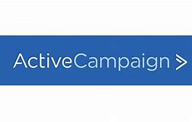
Connect
build an automated relationship
Notes:
Show dashboard for Active Campaign https://christyjohnson.activehosted.com/series/1

Slide 46
Short conversational emails
that gradually introduce your practice to potential clients

Slide 47
Short conversational emails
that gradually introduce your practice to potential clients

Slide 48
Explain
Create a web page, preferably a landing page or squeeze page
Describe your course content and objectives….What will your client learn?
What will you charge?
Will you have bonuses?
What type of content will you offer?
Written material or books to read
Access to private online content
Worksheets
Prerecorded Audio sessions for them to listen to
Prerecorded Video sessions for them to watch
Other
Will you have live audio or video coaching calls? If so…
How many sessions will you have?
How long will they be?

Slide 49
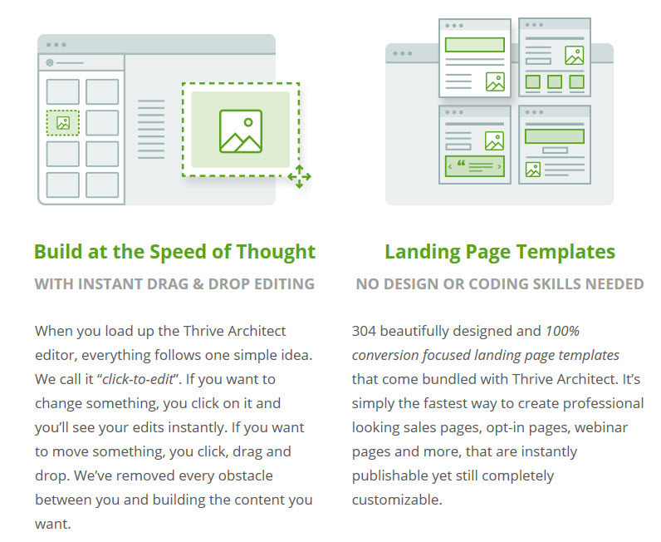
Landing Pages with Thrive Themes

Slide 50
Q & A

Slide 51
If you’d like access to the powerpoint, email me and let me know or give me your business card before you leave

